Slide 1
Affordable Care Act and Super-Utilizers
Lynn Garcia, Kathleen Han, and Aileen Maertens
SW 722
October 1, 2014

Slide 2
Definition
“Super-utilizers” is the term used to refer to patients who accumulate large numbers of emergency department visits and hospital admissions which might have been prevented by relatively inexpensive early interventions and primary care.
Retrieved from: http://medicaid.gov/Federal-Policy-Guidance/Downloads/CIB-07-24-2013.pdf

Slide 3
Introduction
With the implementation of the Affordable Care Act (ACA), many more people will become eligible for Medicaid coverage on January 1, 2014.
New minimum Medicaid income eligibility level. (Hawaii, household of one, monthly income $1487.00)
Hawaii’s Medicaid program is funded through federal and state funds. (State funds mostly comes from general excise tax).
Majority of super utilizers (about 60%) are Medicaid beneficiaries.
Retrieved from: http://www.rwjf.org/content/dam/farm/reports/reports/2013/rwjf407990

Slide 4
What makes a Super Utilizer? / Key Concepts
Super utilizers…
generate high cost each year.
receive fragmented care in acute care settings while lacking access to coordinated care in lower-cost primary care settings.
may have behavioral health issues, such as mental illness or substance abuse.
may face social barriers, such as homelessness.
may have chronic illness.
may not have a primary care physician.

Slide 5
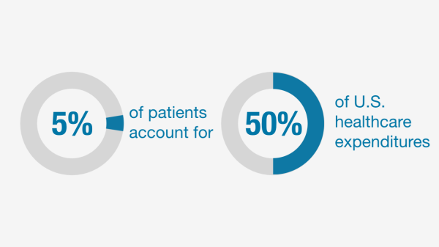
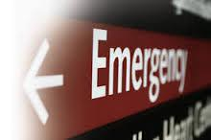
Super Utilizers AKA: Healthcare Frequent Flyers
“[The patient] had severe congestive heart failure, chronic asthma, uncontrolled diabetes, hypothyroidism, gout, and a history of smoking and alcohol abuse. He weighed five hundred and sixty pounds. In the previous three years, he had spent as much time in hospitals as out.” – Atul Gawande, “The Hotspotters,” The New Yorker, January 24, 2011

Slide 6
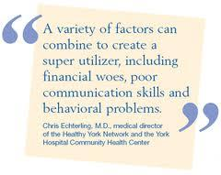
Main Health Concerns of Super Utilizers
Most have 3+ complex medical issues such as heart disease, diabetes and kidney problems
Many also suffer from substance abuse problems, homelessness, and mental health issues
Many need to be on multiple medications and are non-compliant due to other pressing needs

Slide 7
Who are the Super Utilizers?
Medicare beneficiaries who have difficulty affording the medicines they need to control their conditions;
So-called dual eligibles who qualify for Medicaid and Medicare and tend to shift between EDs for treatment for medical conditions tied to substance misuse or homelessness; or
Individuals with private insurance.
According to KHN/Post, many ED super-utilizers require emergency care because they face significant struggles in "navigating the increasingly fragmented, complicated, and inflexible" health care system.
Retrieved from: http://www.advisory.com/daily-briefing/2013/10/08/hospitals-fight-to-bring-down-the-number-of-super-utilizers

Slide 8
How does the law help solve the problem of super utilizers?
Hospitals, health systems, and insurers nationwide have launched initiatives to address the problem of super utilizers, reduce costs, and improve care
ACA encourages healthcare providers to collaborate and combine their resources to offer coordinated cost efficient treatment programs and then share the savings from the effort
Retrieved from: californiahealthline.org

Slide 9
What is being done in Hawaii to address this?
Hawaii Healthcare Project launched in 2012 was initiated as a public - private Partnership
February 2013 Hawaii was awarded $937,691 grant to continue healthcare transformation as part of the agencies State Innovations Model (SMI)
http://hawaiihealthcareproject.org/index.php/resources/healthcare-innovation-plan.html#CareCoordination

Slide 10
Establishment of “Super-Utilizers Pilot Program”
Behavioral Health Pilot
Community Paramedicine Pilot
The Department of Public Safety Pilot
http://hawaiihealthcareproject.org/index.php/resources/healthcare-innovation-plan.html#CareCoordination

Slide 11
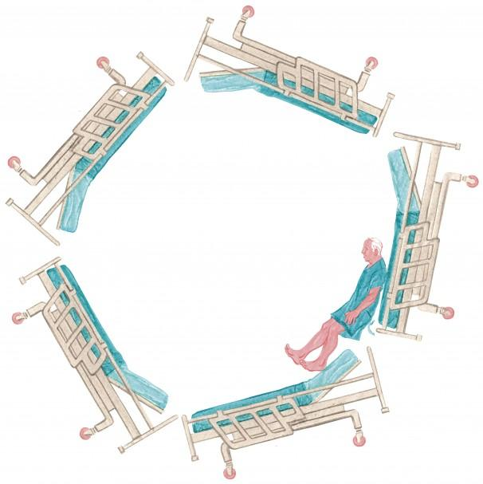
Real Life “Super Utilizer”

Slide 12
Implications for Social Work Practice
Identification of super utilizers
Development of a care management team to include
social worker, nurse, doctor, community health
worker, health coach, etc
Intense discharge planning to include home visits,
ongoing support within the community

Slide 13
Program - Bridges to Health
Example of program addressing needs of super utilizers:
http://www.youtube.com/watch?v=NgfYNPvV30k

Slide 14
Discussion Questions
How do you feel about Super Utilizers?
How would you solve the problems regarding Super Utilizers in Hawaii?

